Slide 1



Xamarin & Cognitive Services
Francesco Bonacci
MSP Tech
francesco.bonacci@studentpartner.com
Twitter: @francibon93
github.com/francibon93

Slide 2
Xamarin

Slide 3
Approccio Nativo
iOS
Android
Windows
Objective-C / Swift
Xcode
Java
Android Studio
C#
Visual Studio
Logica di business duplicata
Linguaggi e IDE diversi
Diversi Team di Lavoro e applicazioni “non in linea”

Slide 4

Xamarin.Native
iOS C# UI
Android C# UI
Windows C# UI
Shared C# Mobile
C# codebase
100% accesso ad API native
Performance ~ Sviluppo nativo

Slide 5

Xamarin.Forms
Xamarin.Forms
Shared C# Mobile
Xaml/C# UI codebase
API di sistema astratte
Performance < Xamarin.Native

Slide 6
Windows APIs
Microsoft.Phone
Microsoft.Networking
Windows.Storage
Windows.Foundation
Microsoft.Devices
System.Net
System
System.IO
System.Linq
System.Xml
System.Data
System.Windows
System.Numerics
System.Core
System.ServiceModel

Slide 7
iOS – 100% API Coverage
MapKit
UIKit
iBeacon
CoreGraphics
CoreMotion
System.Net
System
System.IO
System.Linq
System.Xml
System.Data
System.Windows
System.Numerics
System.Core
System.ServiceModel

Slide 8
Android – 100% API Coverage
Text-to-speech
ActionBar
Printing Framework
Renderscript
NFC
System.Net
System
System.IO
System.Linq
System.Xml
System.Data
System.Windows
System.Numerics
System.Core
System.ServiceModel

Slide 9

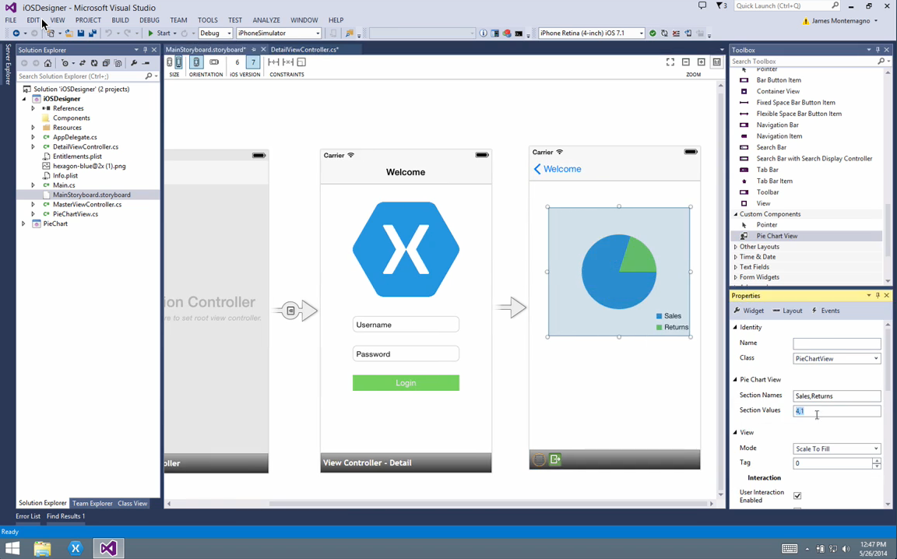
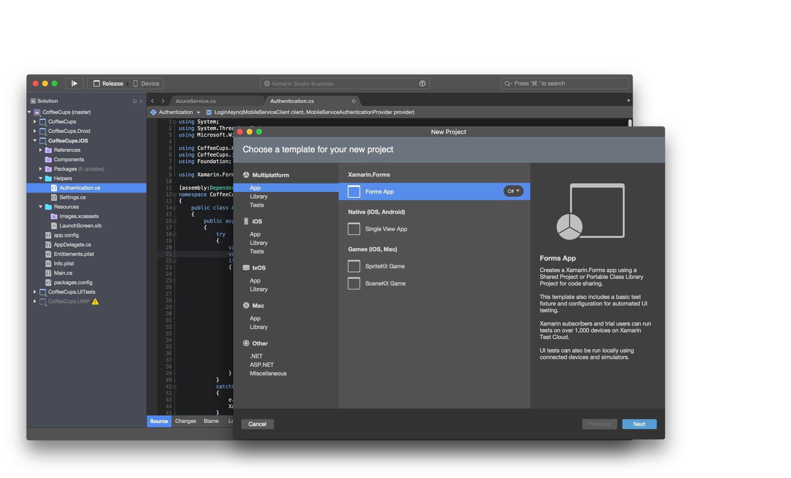
Tool di sviluppo
Visual Studio:
Plugin ora integrato in Visual Studio
Supporto ad Android, iOS e Windows Phone
Xamarin Studio (ora Visual Studio for Mac):
Disponibile sia per Windows che per OS X
Supporto ad Android e iOS (solo su OS X)

Slide 10
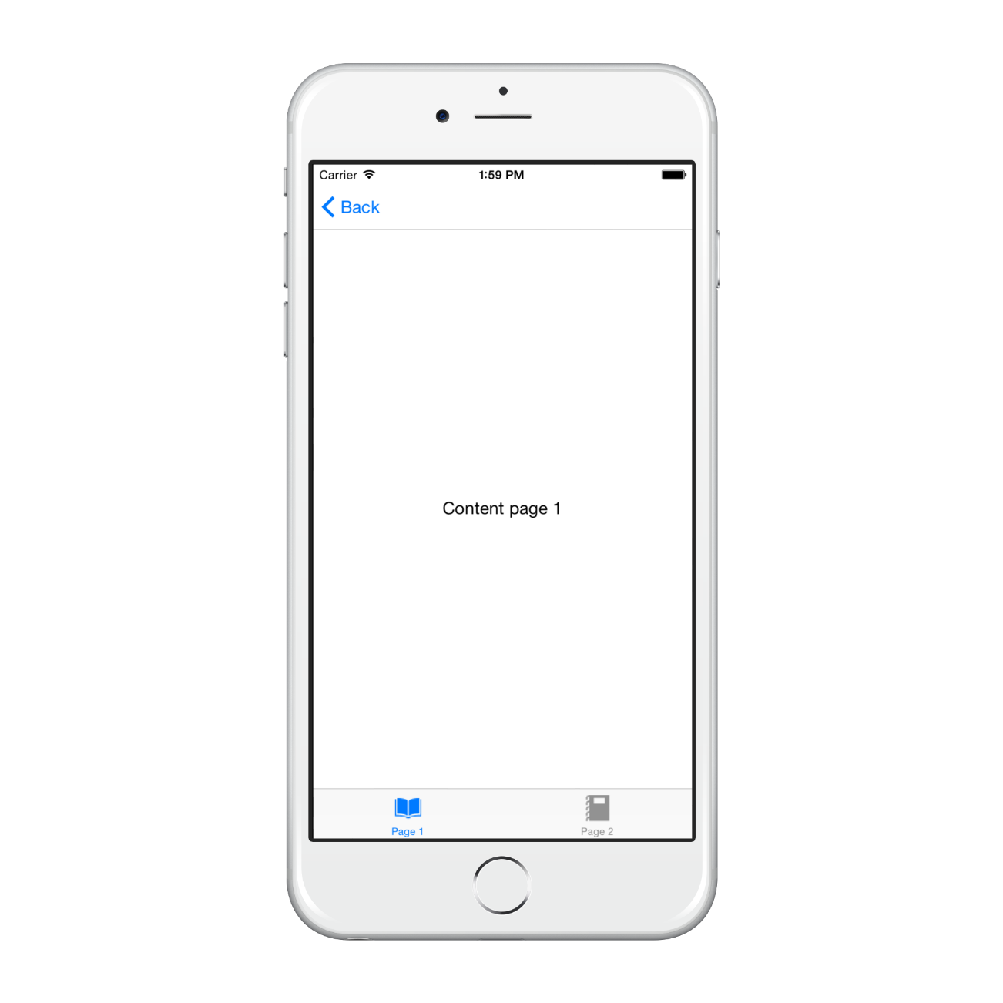
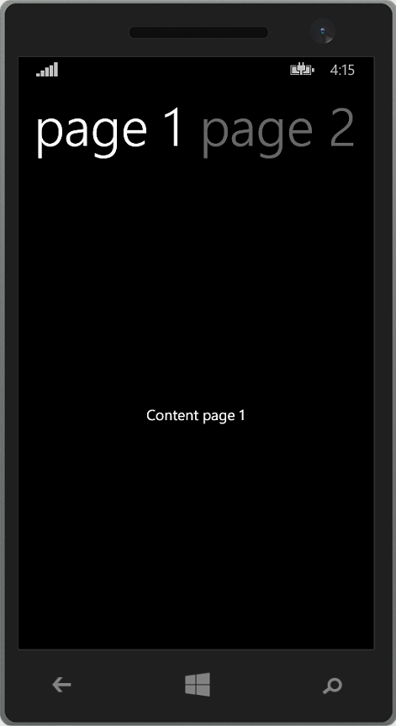
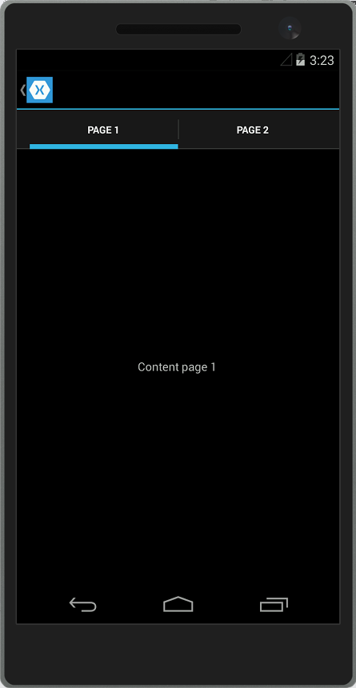
UI con Xamarin.Forms
Unico linguaggio di markup: XAML
Controlli della UI tradotti in controlli nativi a Runtime
Supporto a binding e commading
<TabbedPage />

Slide 11
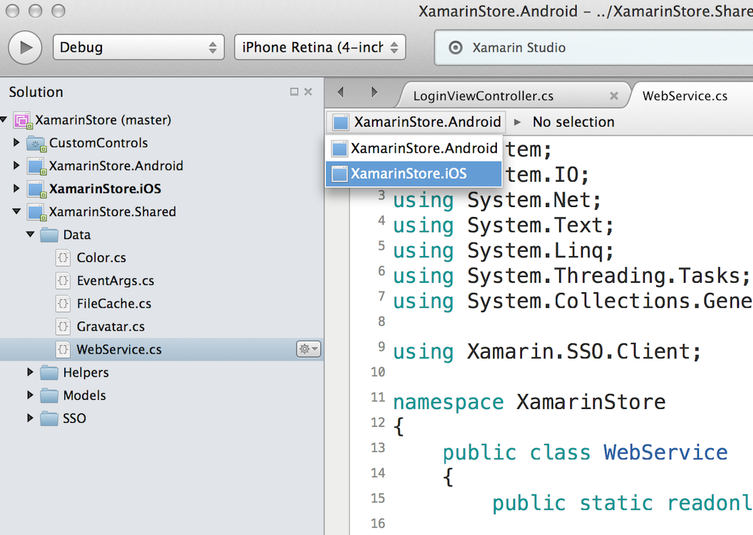
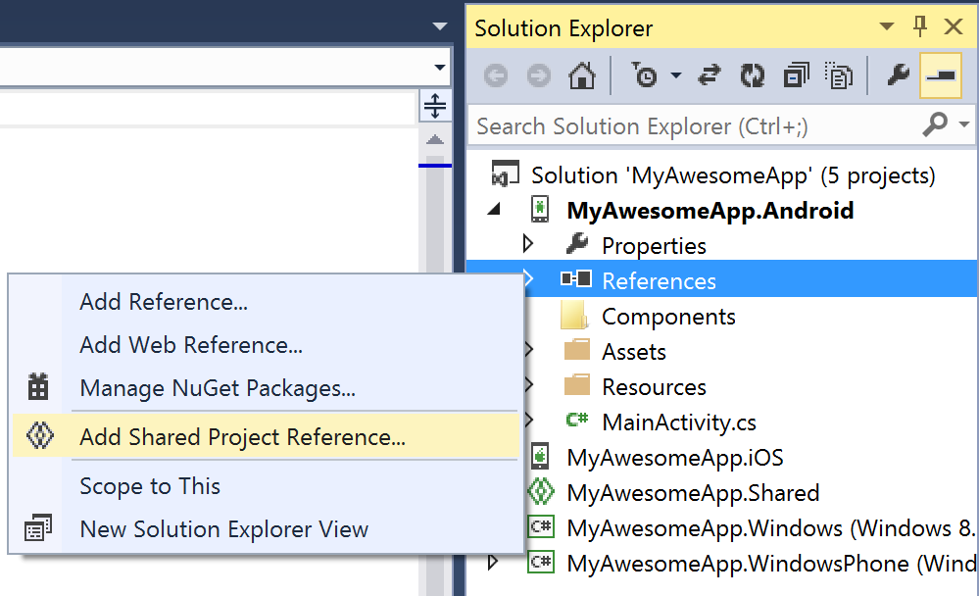
Shared Projects - SP
public void DoSomething()
{
#if WINDOWS_PHONE
//API di Windows Phone / UWP
#endif
#if __ANDROID__
//API di Android
#endif
#if __IOS__
//API di iOS
#endif
}
Compilazione condizionale
Nessuna DLL in fase di compilazione
SP dipendente da progetti specifici Codice Poco comprensibile e testabile!

Slide 12
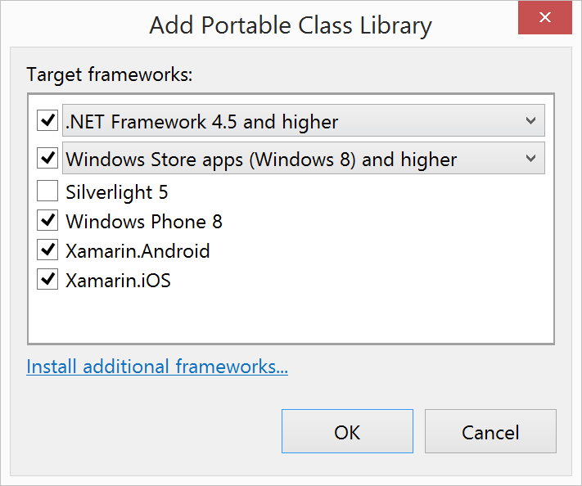
Portable Class Libraries - PCL
namespace SampleApp
{
public interface IGpsService
{
Task<Location> GetLocation();
}
}
[assembly: DependencyService(typeof(GpsService))]
namespace SampleApp.Droid
{
public class GpsService : IGpsService
{
// Native Implemetation...
}
}
Dependency Service
PCL indipendente dai progetti specifici PCL testabile
Subset meno ampio del .NET Framework
DLL in fase di compilazione Overhead!

Slide 13
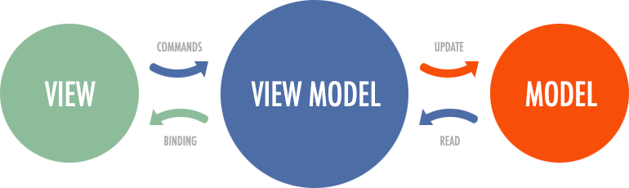
MVVM
Design pattern architetturale ispirato a Model-View-Presenter (e MVC)
Testabile!
ViewModel non conosce direttamente View
Più View possono condividere lo stesso ViewModel
View notifica e viene notificata attraverso Data Binding
View notifica eventi tramite Comandi
Portabile!

Slide 14
Microsoft Cognitive Services

Slide 15






Cognitive Services in Details
Cognitive Services
Vision
Speech
Language
Knowledge
Search
Computer Vision
Customer Recognition
Bing Spell Check
Academic Knowledge
Bing
Web Search
Emotion
Speaker Recognition
Linguistic Analysis
Entity Linking
Bing
Image Search
Speech
Language Understanding
Knowledge Exploration
Bing
Video Search
Face
Text Analytics
Recommendations
Bing
News Search
Video
Web Language Model
Bing
Autosuggest
Translator
Notes:
Introducing the new Bing APIs as part of the Cognitive Services offering

Slide 16
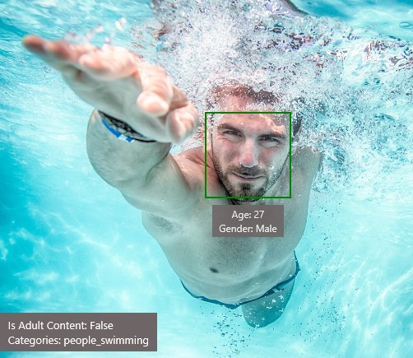
Face APIs
Type of Image:
Clip Art Type
Line Drawing Type Black & White Image
Content of Image:
0 Non-clipart
0 Non-Line Drawing False
Categories
Adult Content Adult Score Faces
[{ “name”: “people_swimming”, “score”: 0.099609375 }]
False 0.18533889949321747
[{ “age”: 27, “gender”: “Male”, “faceRectangle”:
{“left”: 472, “top”: 258, “width”: 199, “height”: 199}}]
Image Colors:
Dominant Color Background Dominant Color Foreground Dominant Colors
Accent Color
White Grey White Blue

Slide 17

Computer Vision APIs
JSON:
{
"language": "en",
"orientation": "Up", "regions": [
{
"boundingBox": "41,77,918,440", "lines": [
{
"boundingBox": "41,77,723,89", "words": [
{
"boundingBox": "41,102,225,64", "text": "LIFE"
},
{
"boundingBox": "356,89,94,62", "text": "IS"
},
{
"boundingBox": "539,77,225,64", "text": "LIKE"
}
...

Slide 18
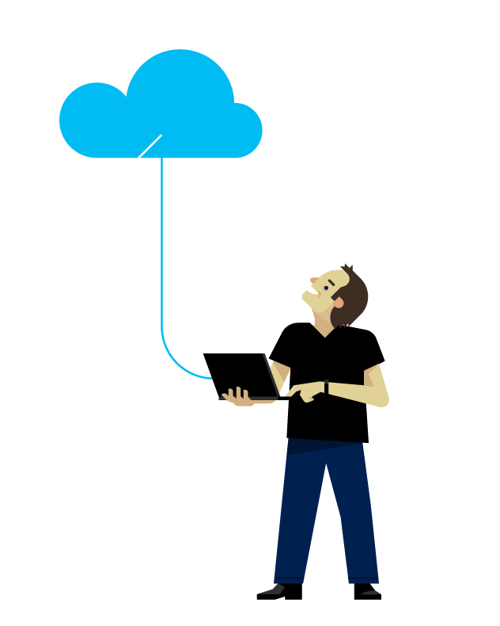

Emotion APIs
Demo
GitHub Repo:
http://bit.ly/2fv0VoD

Slide 19
Fine

Slide 20
Introducing the Seeing AI project
Video:
http://bit.ly/1qk5ZkJ

